Slide 1
EDA
Project
Talal, Ebrahim, Qassim
21/05/2025

Slide 2
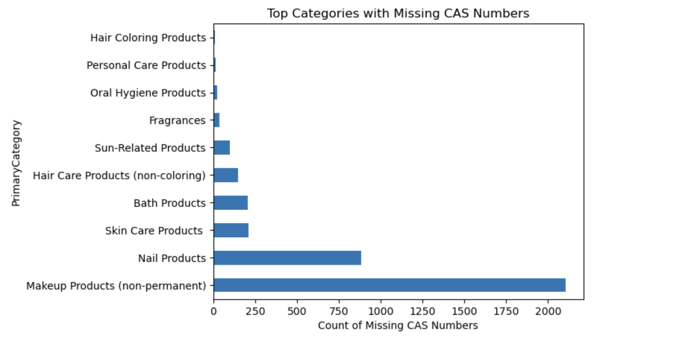
Missing CAS Numbers Crisis
Key Findings
1,750+ hair coloring products lack CAS numbers—critical for safety tracking.
This gap impedes hazard assessments and recalls."

Slide 3
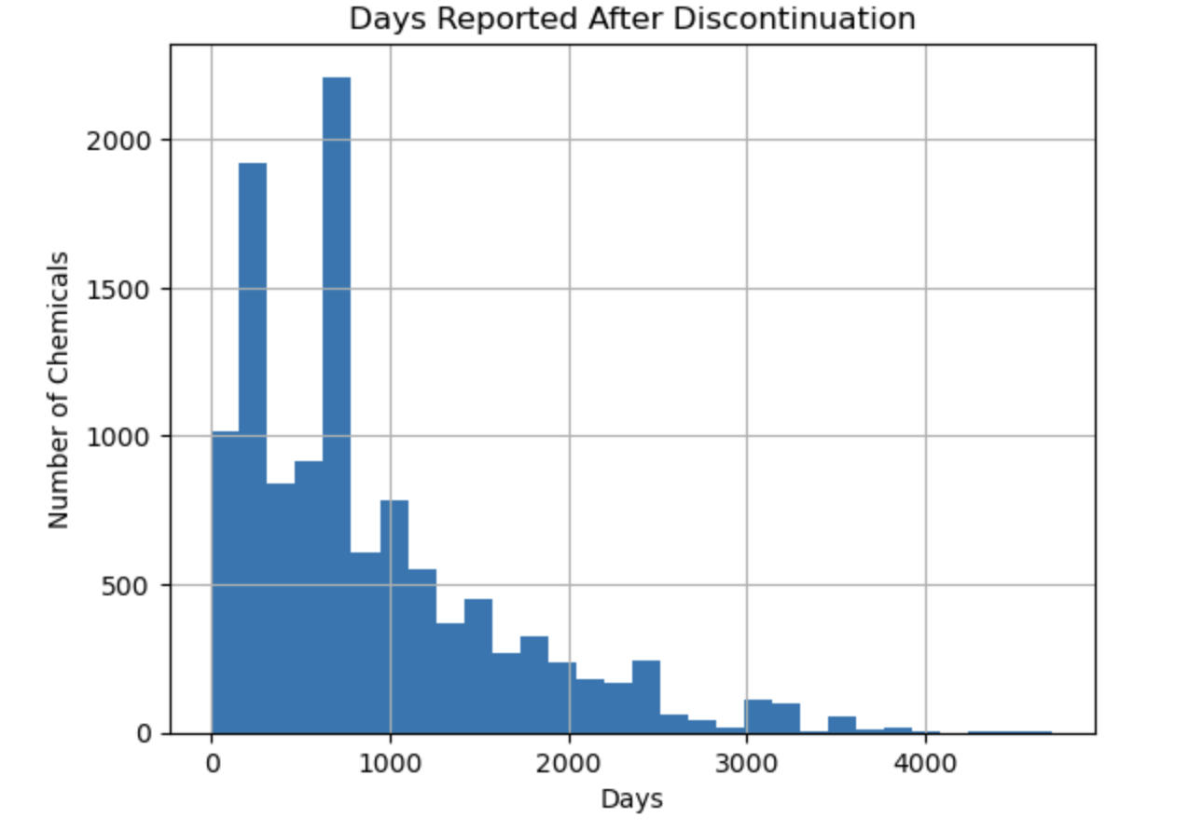
Delayed Hazard Reporting
Alarming Trend
2,000+ chemicals were reported after discontinuation (avg. 1,200 days late).
This delays public safety alerts."

Slide 4
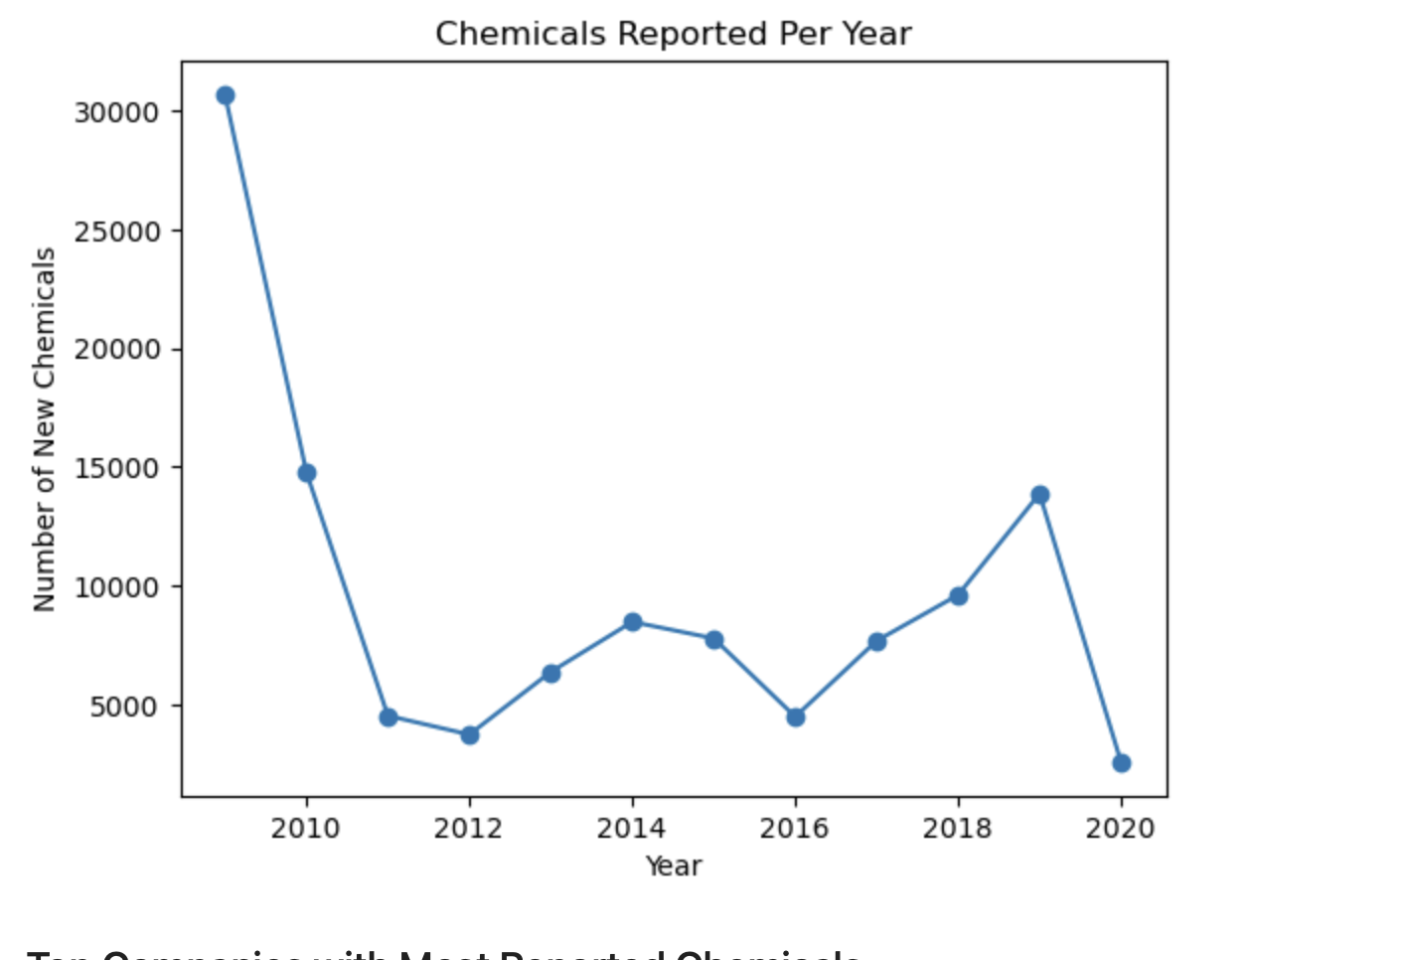
Rising Chemical Volumes
Key Findings
"25,000 new chemicals entered cosmetics in 2010 alone—yet only 13.5% were later discontinued (Screenshot 6). Regulatory oversight is falling behind innovation."

Slide 5
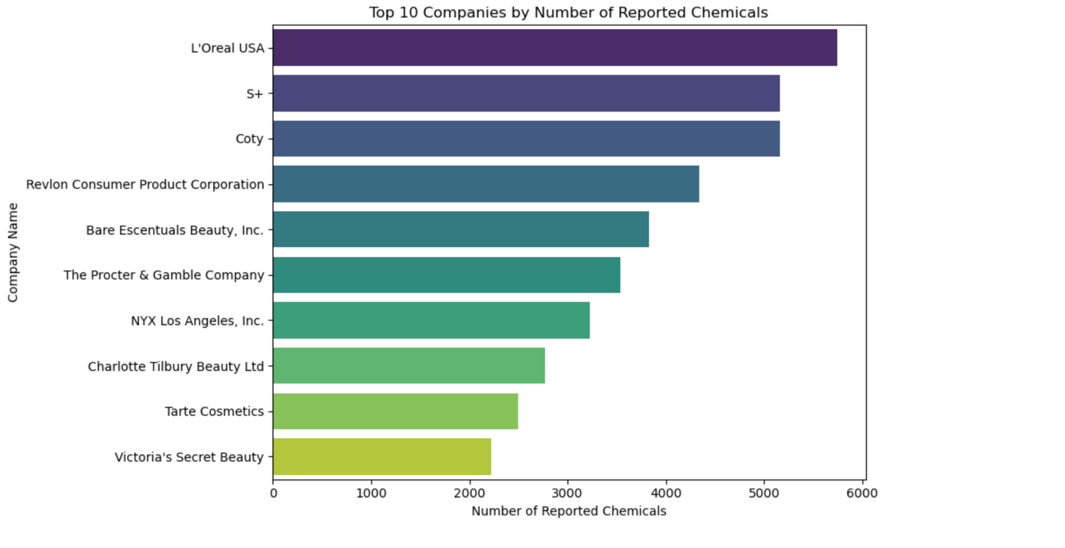
Top 10 Companies
Key Findings
"L'Oreal (5,747 chemicals) and S+ (5,165) dominate reported chemicals.
But high volume ≠ high risk

Slide 6
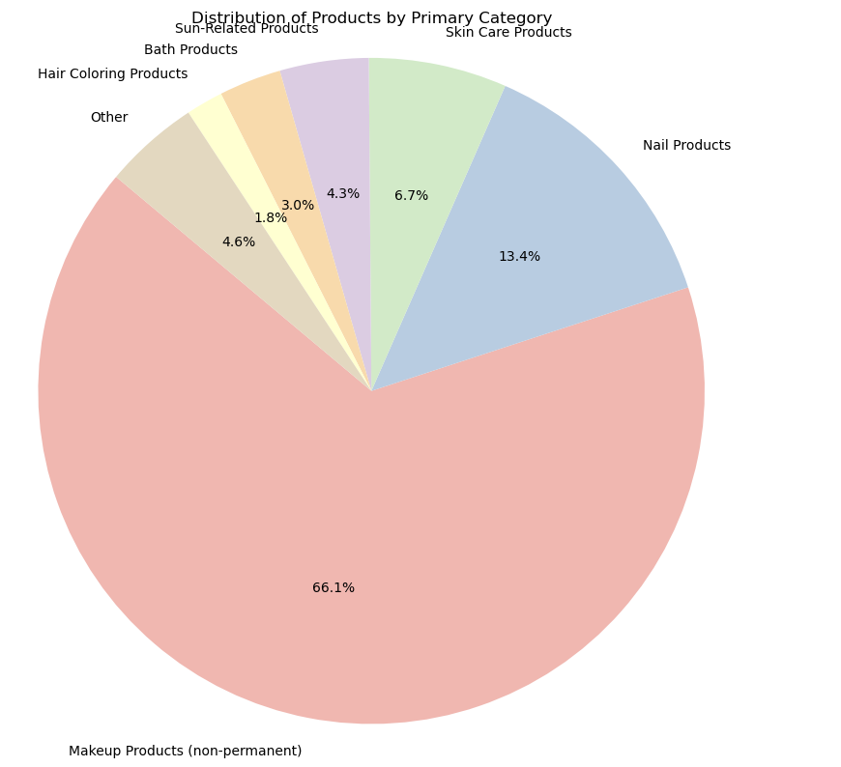
Product Category Risks
Key Findings
"66% of chemicals are in nail/makeup products , with lipsticks (16,555) and eyeshadows (15,744) being top subcategories.
These high-contact areas need stricter safety testing."

Slide 7
Thank You!

